Slide 1
Natural Language Processing
Mandate 3: Syntax Processing

Slide 2
Text Analytics Stack
Meaning
Machine
Translation
Semantic Processing
General knowledge Domain Knowledge
Discourse Context
Question
Answering
Syntactic Processing
Conversational
UI
Language
Tokenization and Shallow Parsing
Lexical Processing
Text
(User Generated Content)

Slide 3
Linguistics Essentials

Slide 4
Syntax Processing
Structural understanding of text
Addresses issues like:
Parts of speech (POS) tagging
Construction of parse trees
Coreference resolution
Managing syntactic ambiguity
Broad approaches for syntax analysis
Language modeling
Corpus based (statistical) processing
Statistical language modeling

Slide 5
Syntax Processing
Parts of speech (POS)
Syntactic class of a term based on the role it plays in a sentence
Substitution rule: Terms belonging to the same POS class can be substituted with one another, to make (syntactically) correct sentences
POS classes: noun, verb, adjective, adverb, determiners, articles, prepositions, particles…
Syntax: The study of regularities of word order and phrase structure

Slide 6
Parts of Speech primer
Nouns (NN)
Terms representing entities and concepts like people, animals, things, etc.
Cases
Proper nouns (NNP) refer to names of entities. Adverbial nouns (NR) can be used as modifiers in a sentence (Ex: north, yesterday, etc.)
Pronouns (PP)
Class of terms that refer to nouns that are somehow salient in the discourse context. Example: He, She, They, etc.
Pronoun Cases
Nominative (PPS) or “subject case’’ pronouns refer to nouns that form the subject of a sentence. Accusative (PPO) or “object case’’ pronouns refer to nouns that form the object of a sentence. Possessive (PP$) pronouns are used when the object describes a possessor. Example: “my car”. Reflexive (PPL) pronouns or “anaphora” refer to possession relationship by the possesse. Example: myself, himself, herself, etc.

Slide 7
Parts of Speech primer
Determiner (DT)
Describe particular reference of a noun. A subtype of determiners are the articles (AT): `a’, `an’, `the’. Demonstratives like `this’ and `that’ are also determiners.
Adjective (JJ)
Describes properties of nouns. Example: red rose, fast car, lazy cat, etc.
Adjectives appearing as nouns depicting the object of a sentence are called predicative. Example: The rose is red. The cat is lazy.
Interrogative Pronouns (WDT)
Also called wh-determiner, these are determiners that occur instead of nouns, and are used for questions and relative clauses. Example: Which, What, Whom, etc.
Verb (VB)
Terms used to describe actions. Examples: ran, threw, walked, etc. Verbs also represent assertions like `is’, `has’, `can’, etc.

Slide 8
Parts of Speech primer
Adverb (RB)
Modifiers for verbs, by specification of place, time, manner or degree. Example: I rarely travel abroad.
Preposition (IN)
Terms that express spatial relationships like under the bus, over the city, in the car, etc. Prepositions that are bonded into a verb phrase are called “particles”. Example: take off, sign in, take on, etc.
Conjunction (CC)
Terms connecting two parts of a sentence.
Coordinating conjunctions conjoin two terms of the same category. Example: Husband and wife. I almost bought the house, but decided against it.
Subordinating conjunctions or “complementizers” serve to extend and explain the first part of the sentence. Example: They were able to catch the plane, despite heavy traffic to the airport.

Slide 9
POS primer
Constituents
Specific groupings of words being able to occur in various positions with uniform syntactic possibilities
Paradigmatic relationship
Elements in a constituent that can be replaced for one another to make (syntactically valid) sentences, are said to be in the same “paradigm.”
The cat The big cow She Everyone All the animals | ran jumped walked | across the fence to the other house up the stairs
NP | VBD | NP

Slide 10
POS primer
Syntagmatic relationship
Words that usually form a phrase (called a syntagma) in a paradigmatic context, are said to be in a syntagmatic relationship
Examples:
Gray hair
Sewed clothes
Sad eyes
Noun Phrase (NP)
A syntagma around a central noun term. Typical paradigmatic roles of NP include:
Subject/object of an assertion
Arguments of verbs
Participants in an action
Activity or state description of a verb
May comprise of the following elements:
Determiner
Adjective phrases
Noun head and modifiers
Prepositional or clausal modifiers
NP Example:
The clueless cat that fell into the ditch yesterday.
DET ADJ NN VB NN MOD

Slide 11
POS primer
Prepositional Phrase (PP)
Phrases headed by a preposition and containing a noun phrase complement.
Verb Phrase (VP)
A phrase with a verb at the head, and other elements of the sentence that syntactically depend on the verb.
Example: Ensuring the safety of my passengers was my first priority.

Slide 12
Syntax Analysis
Word Orders
In some languages (most Indian languages) word inflections are used to indicate the role played by the word in a sentence.
Because of this, words can be written in any order without changing the meaning of the sentence (but may alter the relative emphasis).
Example:
श्यामने सूरजको बधाई दिया
सूरजको श्यामने बधाई दिया
बधाई सूरजको श्यामने दिया
In languages like English, word orders are more restricted, and appear mostly in the following form (active voice):
Subject -- Verb (Predicate) -- Object
Example:
Shyam complimented Sooraj
Subject
Verb
Object

Slide 13
Syntax Analysis
Word orders
“Interrogative sentences” that ask a question, usually have the word order reversed between the subject and the first auxiliary verb.
Example:
Will the teacher take the class today?
Auxiliary verb
Subject
Object
In “imperative” statements that urge for a particular action, there is no subject.
Example: Stop the car!
Verb
Object
“Normal” sentences (in contrast to imperatives and interrogatives) are called “declarative” sentences.

Slide 14
Syntax Analysis
Grammars
Syntactic structure of sentences are parsed by the use of formal structures called “grammar”
A grammar is typically in the form of a set of “rewrite rules” of the form A → β, where A represents a “non-terminal” symbol, and β represents a set of rewrite options, where each option is a sequence of either non-terminal or terminal symbols.
S → NP VP
NP → AT NNS | AT NN | NP PP
VP → VP PP | VBD | VBD NP
PP → IN NP
AT → the
NNS → birds | rivers | students
VBD → ran | flew | slept
IN → in | of
NN → bank

Slide 15
Syntax Analysis
Context-free grammars
If the expansion of a non-terminal symbol can be specified independent of the context where it appears, the grammar is said to be “context-free” (CFG). If the expansion of a non-terminal depends on the surrounding context, such grammars are called “context-sensitive” (CSG).
Most syntactic analysis of sentences can be specified using context-free grammars
In a context-free grammar, derivation rules are of the form:
A → β
where A is a single non-terminal symbol appearing on the left-hand side of a rule.

Slide 16
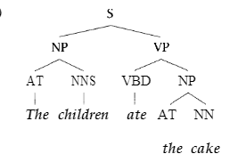
Syntax Analysis
Non-terminal symbols in a grammar are also called the Part of Speech (POS) tags
The set of all terminal symbols in a grammar forms the lexicon or the vocabulary.
The resolution of a sentence into its constituent parts is called a “parse tree” of the sentence.
Parse tree for the sentence:
The children ate the cake
Image source: [MS99]

Slide 17
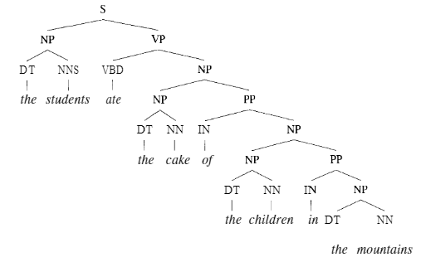
Syntax Analysis
Recursivity
The non-terminal symbol in the LHS of a rule, may appear in the RHS as well. For example:
NP → NP PP
A “noun phrase” can expand to a “noun phrase” followed by a “prepositional phrase”.
Such derivations lead to recursive expansions of sentence structures.
Image source: MS 99

Slide 18
Syntax Analysis
Dependencies
In any declarative sentence, describing an action or characterizing something, the noun phrases are “arguments” for the primary verb phrase.
The noun phrases are also called “dependents” of the verb phrase.
Similarly prepositional phrases (PP) that modify NP or VP, form their dependencies.
Consider the sentence:
The man jumped from the moving train into the river.
For the verb “jumped”, the nouns “man” and “train” are dependents. The PP “into the river” modifies the verb phrase
jumped(man, from(moving(train)))
forms another dependency.

Slide 19
Syntax Analysis
Non-local dependencies
Recursivity in a grammar rule implies a “pumping” property -- where two parts of a parse tree may be separated by arbitrarily large distance, because a recursive element resulted in several elements to be “pumped” in between.
Consider the sentence:
The animals that were trapped in the forest fire and spent three days on an isolated barn, were finally rescued yesterday.
The verb “were” has a dependency in the noun “animals”, at the head of the sentence.
A local skip-gram neighbourhood of “were” would likely miss the dependent noun.

Slide 20
Syntax Analysis: Roles
Agent
Agent of an action is the person or thing that is doing something.
Patient
Patient of an action is the person or thing that is having something done to it
Subject
Noun which represents what a given sentence is about.
Object
Noun that affects, or is affected by the subject of the sentence
Active voice
Subject is the agent and object is the patient.
Example: Five hundred students conducted an experiment.
Passive voice
Object is the agent, and subject is relegated to an oblique reference
Example: An experiment was conducted by five hundred students.

Slide 21
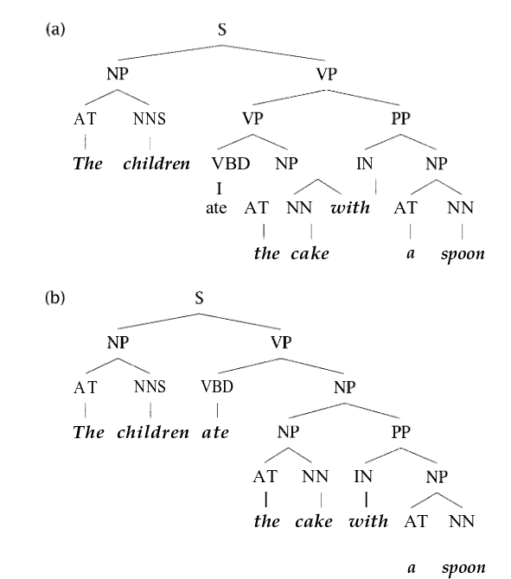
Syntax Analysis: Ambiguity
Most natural languages are inherently ambiguous, resulting in multiple possible parse trees for the same sentence.
Most common form of ambiguity is the attachment ambiguity.
Figure represents two parse trees for the sentence:
The children ate the cake with a spoon
ate(“the children”, “the cake)with(“a spoon”)
ate(“the children”, “the cake with a spoon”)
Image source: [MS 99]

Slide 22
Tagging

Slide 23
Tagging
Also called “shallow” parsing
Addresses the problem of identifying strings into linguistic parts of speech and/or semantic entities of interest
Most commonly implemented using linear models and an assumption of locality of reference

Slide 24
Markov Models
Stochastic models developed to interpret sequential dependencies across words in a language.
Markov models eventually evolved into generic stochastic models for interpreting diverse phenomena.
Markov Process
Given a sequence of random variables (X₁, X₂, … X_{T}), they are said to form a Markov process iff:
The Markov process is said to be “time invariant” if the transition probability P(X_{i+1}|X_{i}) remains the same regardless of how many times a given state is visited by the process.

Slide 25
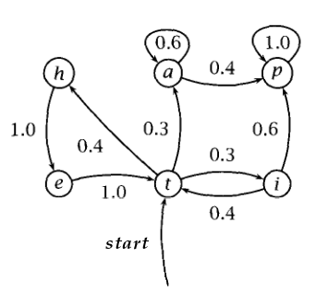
Markov Models
A time-invariant Markov process is typically represented as a “probabilistic state transition diagram”
The process starts with an initial distribution π₀ representing the probability with which the process is in any given state.
Alternatively, the process is given a unique “start” state s₀ with a transition probability to each other state given by π₀.
Transition probabilities on edges are represented by a square matrix T. Progression of the Markov Process is given by:

Slide 26
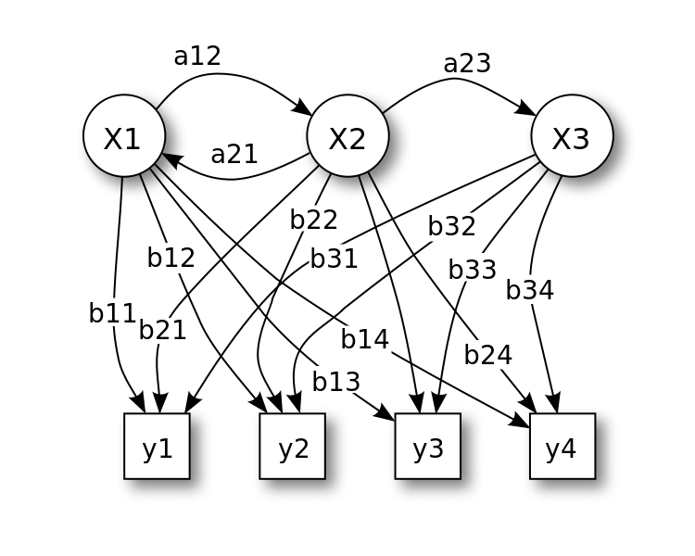
Hidden Markov Model
In a Markov Process, the states of the process are known.
Often, we need to deduce the latent state of an underlying Markov process, based on observed outcomes.
A HMM is a Markov process comprising of some latent states (X₁, X₂, … X_{T}) which are unseen. From each state, one can see one or more outcomes. The set of all possible outcomes (Y₁, Y₂, …, Y_{N}) is called the vocabulary of the HMM.
Image source: By Tdunningvectorization: Own work - Own work, CC BY 3.0, https://commons.wikimedia.org/w/index.php?curid=18125206

Slide 27
Hidden Markov Model
General form of the HMM is as follows:
HMM = (S, A, π₀, T, B)
Here, S is the set of latent states, A is the alphabet of output symbols, π₀ is the initial distribution, T is the set of state transition probabilities, B is the output distribution from each state.
Overall working of a HMM
start at the initial state specified by π₀
i ← 0
while true do
Move from state s_{i} to s_{j} based on probability t_{ij}
Emit observation symbol a_{k} based on probability b_{jk}
done
Questions for HMMs
Decoding: Given a model μ = (T, B, π₀) compute the probability of a given output string O, i.e. P(O|μ)
Given an observation string O and a model μ, compute a state sequence (s₁, s₂, … s_{m}) that best explains the observations
Given an observation string O and a set of possible models (μ₁, μ₂, … μ_{n}) choose the best model to explain the observed sequence.

Slide 28

Hidden Markov Model
Decoding
Given an observed string O = (o1, o2, … oT) and a HMM model μ, any state sequence (S₁, … S_{T}) generates the observed string with the following probability:
Probability of observation is modeled over all possible state sequences that can result in the observation.
Optimal value computed by heuristics like dynamic programming.

Slide 29

Hidden Markov Model
Explanation
The explanation problem is to identify a state sequence S₁, S₂, … S_{T} from a set of N states in model μ, that best explains a given observation O = o₁, o₂, … o_{T}.
This is given by:
Viterbi heuristic:
A dynamic programming heuristic that generates a sequence of states such that, at every step, the probability of generation of the observed sequence till that point, is maximized.
d_{j}(1) = π₀ (s_{j}) // for all states s_{j} in μ
for t = 2 to T do
d_{j}(t) = max_{1≤ k ≤ N} d_{k}(t-1) a(s_{k},s_{j}) b(s_{j},o_{t}) // for all states s_{j} in μ, calculate the maximum probability of reaching
q_{j}(t) = arg max_{1≤ k ≤ N} d_{k}(t-1) a(s_{k},s_{j}) b(s_{j},o_{t}) //backtrace -- the state by which the current state was reached
Deduce the path by backtracing from the state j with the maximum value of d_{j}(T).

Slide 30
Hidden Markov Model
Model Discovery
Given an observation sequence O and a model μ, find the parameters of μ that best explain O.
Modeled as a hill-climbing algorithm reaching a local optima, based on a random initial configuration of parameters
Expectation Maximization (EM) algorithm
Start with a random initial configuration of a model μ⁰ = (T⁰, B⁰, π₀⁰)
Generate the decoding probability for O: P(O|S,μ⁰)
At every step i
Generate a set of candidates μ₁^{i},...μ_{k}^{i} for an improvement of the model μ^{i} by varying values of independent parameters
Generate the decoding probability P(O|S,μ_{j}^{i}) for each candidate
break; if none of the candidates have a better generating probability than μ^{i}
μ^{i+1} ← μ_{j}^{i} where μ_{j}^{i} was the candidate with the maximum decoding probability
return μ^{i} obtained at the break point.

Slide 31
POS Tagging
Syntagmatic tagging
Syntagmatic, or rule-based approaches contain specifications of commonly occurring POS sequences. Using this syntagma, the best rule is applied for tagging a sentence.
For example, the sequence AT JJ NN is much more common, while the sequence AT JJ VB is almost impossible. Hence, in the phrase:
The latest play
The term “play” is much more likely to be tagged NN rather VB.
Lexicon based tagging
In this approach, a large lexicon is maintained, where the POS distributions of different words are maintained.
For instance, the term “bus” is much more likely to be used as NN rather than VB.
In any sentence, probabilistically assign a tag to a word based in its distribution from the lexicon.
Even such “dumb” approach to POS tagging has given an accuracy of more than 90% in experimental settings!

Slide 32



POS Tagging
Markov model taggers
In this approach, the sequence of POS tags in a text is modeled as a time-invariant Markov process.
The tags are modeled as latent states of a HMM, which produce observable outcomes in the form of words.
The HMM model transition probabilities are learned from a training dataset of manually tagged corpus as follows:
where C() is the frequency function.
Emission probabilities of terms are computed as:
where C(t^{k},w) is the number of times word w has been assigned the POS tag t^{k} in the training dataset, and C(t^{k}) is the number of times the POS tag t^{k} has appeared in the training data.
The initial distribution vector π₀ is computed as:

Slide 33
POS Tagging
Markov model taggers
Once a model is constructed based on training data, for any given sentence as a sequence of observed outcomes o₁, o₂… o_{T}, the underlying state (tag) transition sequence can be computed, as seen in the “explanation” problem earlier:

Slide 34
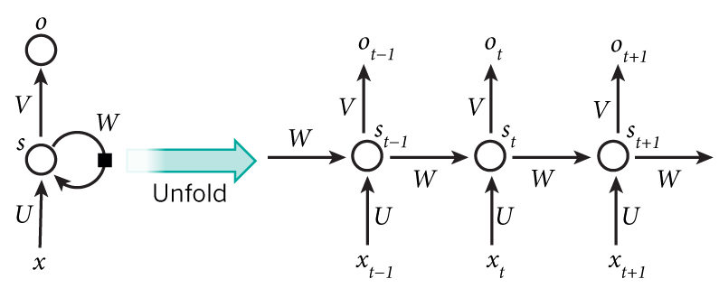
POS Tagging
RNN based approach
More recent “deep learning” model, that is trained over sequence data.
An RNN comprises of a single stage that has a “feedback” based on the result of the previous step.
Input to an RNN at step t:
x_{t}: a n-dimensional 1-hot input vector representing the current word being processed
s_{t-1}: an m-dimensional vector representing the state obtained at the previous step
Image source: http://www.wildml.com/2015/09/recurrent-neural-networks-tutorial-part-1-introduction-to-rnns/

Slide 35

POS Tagging
RNN Taggers
The i^{th} element of state s_{t} at stage t is calculated as:
where W^{i} is the weight vector corresponding to the i^{th} neuron representing the state.
The output vector o_{t} from stage t is an m-dimensional vector computed from the state s_{t}:
o_{t}
V
tanh()
s_{t-1}
W
s_{t}
U
x_{t}

Slide 36
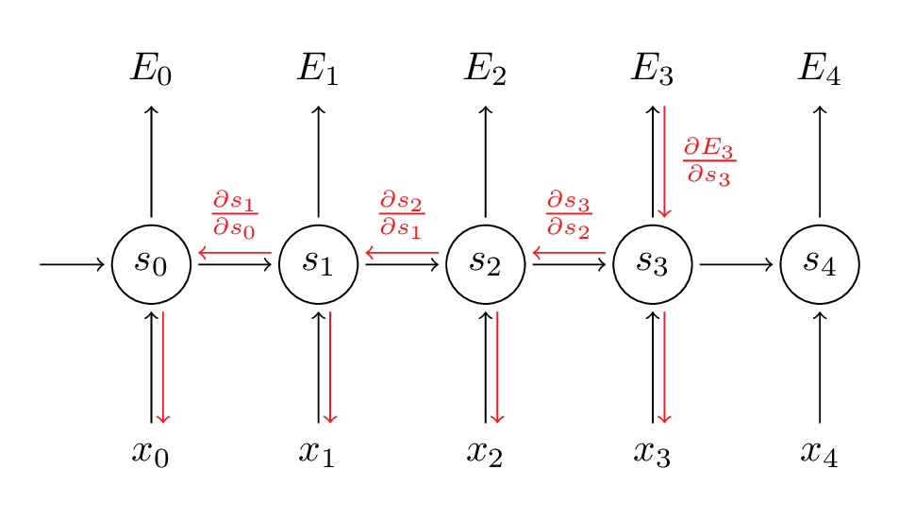
POS Tagging
RNN Taggers
Learning in an RNN is based on “Backpropagation Through Time” (BPTT)
BPTT out of scope for this module
RNNs unsuitable for long-range dependencies across terms (for example, due to recursive injection of a parse tree mid-sentence).
LSTM (Long Short Term Memory) offer attractive alternatives to RNNs.
Image source: http://www.wildml.com/2015/10/recurrent-neural-networks-tutorial-part-3-backpropagation-through-time-and-vanishing-gradients/

Slide 37
Grammar Induction

Slide 38
Context Free Grammar
Syntactic analysis of a sentence entails understanding the different POS tags of terms in the sentence, and relationships between them.
This is accomplished (typically) by means of a “context-free grammar (CFG)” which are written in the form of a set of “production rules”
Syntactic analysis of a sentence is called “parsing” and the result of parsing is a “parse tree”
Definition of a CFG:
CFG = (N, V, R, N¹)
where:
N is a set of “tags” or non-terminal symbols
V is a set of “terms” or “vocabulary”
R ⊆ N x (N ∪ V)* is a set of “production rules” or “rewrite rules” that convert a tag into a string of terms and tags.
N¹ ∊ N is a unique start tag

Slide 39
Parsing
Given a string s, a parse tree for that string may be generated in two ways:
Top-down parsing: Start from the start symbol and keep generating intermediate strings until the string s is generated. Example: LL(k) parsers.
Bottom-up parsing: Keep replacing substrings of the given input string s by non-terminals that generate them, until the string reduces to the start symbol. Example: LR(k), LALR parsers.
CFG for a simple expression parser
S ⇒ S+S | S*S | S/S | S-S | (S)
S ⇒ var
var = {x,y,z,t}
Top-down parse for the sentence: x+(y*z)/t
S ⇒ S+S ⇒ x+S ⇒ x+S/S ⇒ x+(S)/S ⇒ x+(S*S)/S ⇒
⇒ x+(y*S)/S ⇒ x+(y*z)/S ⇒ x+(y*z)/t

Slide 40
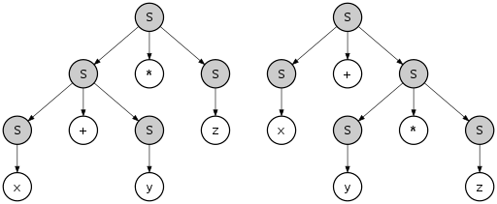
Ambiguity
A given sentence may be parsed in several ways resulting in multiple parse trees.
Most languages are inherently ambiguous, especially natural languages.
“The children ate cake with a spoon”
Most likely parse
Natural language sentences usually have exponentially many parse trees in comparison to the number of terms in the sentence.
We are hence, interested in deriving the “most likely parse” of a given sentence.
Two possible parse trees for the expression:
x + y * z
Image source: Wikipedia.
Citation: By Pat Hawks - Own work, CC BY 4.0, https://commons.wikimedia.org/w/index.php?curid=66317627

Slide 41
Probabilistic Context Free Grammars
PCFGs also called Stochastic CFGs represent linguistic structures as rewrite rules seen earlier, but with generation probabilities attached to them
Useful for “deep” parsing of sentences, and resolving non-local dependencies and ambiguity
Elements of a PCFG
Lexicon or set of terminal symbols: w^{k}, k = 1 .. V
Tags or non-terminal symbols: N^{i}, i = 1 .. n
Unique start tag: N¹
Generation rules of the form N^{i} → β^{j}
For each rule probability of generation:
V^{i,j} : (N^{i} → β^{j}) → [0,1]
such that, the probabilities add up to 1 for rules with the same head:
∑_{j} V^{i,j} = 1

Slide 42
PCFGs
Parsing or syntax analysis performed on a sentence basis
A sentence is modeled as a sequence of words:
w₁, w₂, … w_{m}
The term w_{ab} is used to represent a substring comprising of w_{a}, w_{a+1}, …, w_{b}
A tag N^{i} is said to “derive” or “dominate” or “yield” w_{ab}, denoted as:
N^{i} →* w_{ab}
if w_{ab} can be derived by one or more application of rules from N^{i}
Probability of a sentence w₁, w₂, … w_{m} given a grammar G is computed as:
P(w_{1m}) = ∑_{t} P(w_{1m}, t)
= ∑_{yield(t) = w_{1m}} P(t)
over all parse trees t for the sentence.

Slide 43
PCFG
Consider the PCFG with the generation probabilities as shown to the right, and the following sentence:
Astronomers saw stars with ears
PCFG independence assumptions:
Place invariance: Probability of a tag generating a substring remains the same, regardless of where the substring appears in the sentence
Context-free: Probability of a subtree does not depend on words not in the subtree
Ancestor-free: Probability of a subtree does not depend on the probability of the generation of the root of the subtree
With the above assumptions, probability of a parse tree can be computed by multiplying the probabilities of its subtrees in a bottom-up fashion.
S → NP VP (1.0)
PP → P NP (1.0)
VP → V NP (0.7) | VP PP (0.3)
NP → NP PP (0.4)
P → {with (1.0)}
V → {saw (1.0)}
NP → {astronomers (0.1), ears (0.18), saw (0.04), stars (0.18), telescopes (0.1)}

Slide 44
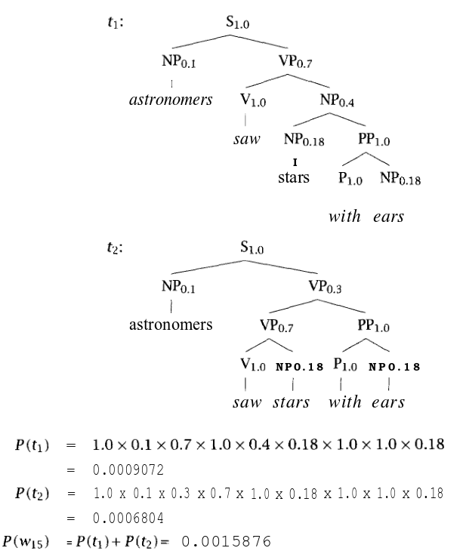
PCFG
Example sentence with two possible subtrees and their respective probabilities
PCFGs are useful for “grammar induction” -- or learning plausible grammatical parse trees based on positive samples alone
PCFGs also called probabilistic language model
The parse tree with the highest probability is called the “most likely parse” of the sentence.
Usually, the number of parse trees for a given string, are exponentially many -- requiring the need for better approaches for computing the most likely parse.
Image source [MS99]

Slide 45
PCFG
Inside and Outside Probabilities
In any grammar G, the “inside probability” of a string w_{pq} given a tag N^{j} ß_{j}(p,q) = P(w_{pq}|N^{j}) is the total probability of generating w_{pq} starting from the tag N^{j} in the grammar.
In any grammar G, the “outside probability” α_{j}(p,q) of a tag Nj is the total probability of deriving N^{j} as part of an intermediate derivation of the form: w_{1(p-1)} N^{j} w_{(q+1)m} starting from the start symbol N¹.
N¹
w₁ N^{j} w_{m} ⇒ α_{j}(p,q)
w_{p} w_{q} ⇒ ß_{j}(p,q)

Slide 46
PCFG
Inside and Outside probabilities can be used in a CFG written in Chomsky Normal form, to greatly reduce the complexity of finding the most probable parse of a sentence.
Chomsky Normal Form
Every CFG can be written in Chomsky Normal Form (CNF), where production rules are of the following form:
A → BC
A → a
S → ε
Here A, B, C are tags (non-terminals), a is a term (terminal), S is the start tag (N¹) and ε is the null string.

Slide 47
PCFG
A Viterbi Heuristic can be adopted to find the most likely parse either in a bottom-up or in a top-down fashion.
Given a CFG for a language, and a corpus of documents, obtaining the probabilities for each production rule, to form a PCFG is called “training” the PCFG.
Training PCFGs out of the scope of this module
Algorithm for most likely parse
Initialization: For every term that is generated by a tag, find the most likely parse by maximizing its inside probability:
Induction: For every substring whose most likely parse is now rooted at N^{j}, N^{k}, find the most likely parse N^{i}, that maximizes the inside probability of generating N^{j}, N^{k}:
Store backtrace:
3. Terminate when the start symbol is reached.

Slide 48
Treebanks
Grammar induction tools based on PCFGs are inefficient and unreliable in practice, given the large number of possible parse trees for even the simplest of sentences in natural language.
To expedite this, commonly available parse trees are often maintained as a knowledge base separately, and are called “treebanks”.
Example Treebank projects:
Penn Treebank (English): https://catalog.ldc.upenn.edu/ldc99t42
Tuebingen Treebank for English: http://www.sfs.uni-tuebingen.de/en/ascl/resources/corpora/tueba-es.html
Hindi Dependency Treebank: http://ltrc.iiit.ac.in/treebank_H2014/

Slide 49
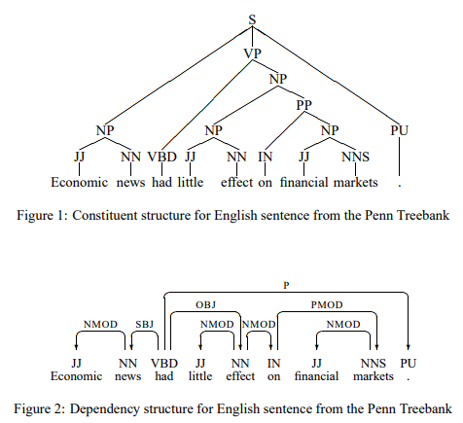
Dependency Grammars
Grammars we saw till now, are based on assigning different POS tags to elements in a sentence, and parsing them using a set of production rules across tags.
Such kinds of grammars are called “constituency” grammars.
In contrast, “dependency grammars” also called “word grammars” are based on identifying role dependencies between words in a sentence.
Dependency grammars can be traced back to Panini’s grammar for Sanskrit in the second millennium BCE.
Image source: [Niv 05]

Slide 50
Dependency Grammar
Dependency grammar is not any specific grammar -- but refers to a specific way in which syntactic structures are described.
Dependency grammars best suited to parse free word-order languages (most Indian languages)
Constituency grammar: Based on the notion that groups of words can be grouped into a semantic unit like “noun phrase”, “verb phrase” etc.
Dependency grammar: Based on the notion that words play different “roles” in a sentence, like “subject”, “modifier”, “object”, etc. and are dependent upon one another.
Dependencies are represented as labeled arcs of the form h → d (l) where h is called the “head” of the dependency, d is the “dependent” and l is the “label” assigned to the arc.
Dependency arcs for a sentence form a rooted tree, rooted at the main verb or predicate representing the sentence.

Slide 51
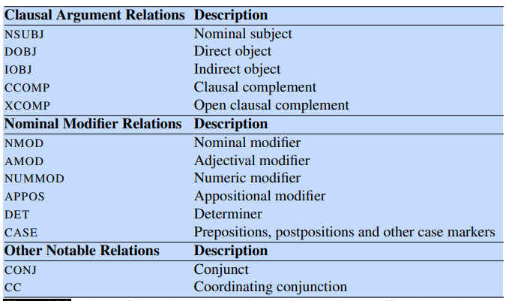
Universal Dependencies
Developed by the Universal Dependencies Project, to create a set of cross-lingual dependency relations. Nivre, J., M.-C. de Marneffe, F. Ginter, Y. Goldberg, J. Hajic,ˇ C. D. Manning, R. McDonald, S. Petrov, S. Pyysalo, N. Silveira, R. Tsarfaty, and D. Zeman. 2016. Universal Dependencies v1: A multilingual treebank collection. LREC.

Slide 52
Universal Dependencies
A cross-lingual, universal framework for dependency annotation, developed as part of the Stanford Dependencies project
Universal Dependencies Specification: http://universaldependencies.org/
Universal dependency relationships (non-exhaustive list):
nsubj: Nominal subject of a clause
Trump defeated Clinton
defeated -- nsubj → Trump
obj: Object of a verb in a clause
defeated -- obj → Clinton
csubj: Clausal subject, where the subject itself is a clause
What he did, made a lot of difference.
made -- csubj → did
ccomp: Clausal complement. A verb that complements the main verb of the sentence.
She said, you adore oranges
adore -- ccomp → said

Slide 53
Universal Dependencies
iobj: Indirect object -- an argument of a verb that is not its subject or direct object.
He gave me a compliment
gave -- iobj → me
nmod: Nominal modifier. A nominal dependent of another noun.
Office of the Dean
Office -- nmod → Dean
acl: Clausal modifier of a noun. Head of a clause that modifies a noun.
She entered the room jubilant
She -- acl → jubilant
amod: Adjectival modifier. An adjective that modifies the meaning of a noun
Our farm uses organic manure
manure -- amod → organic

Slide 54
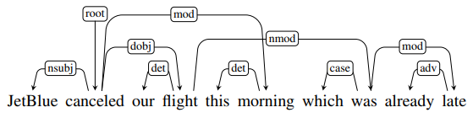
Projectivity
A dependency tree is said to be projective, if given a head node and a dependent node in the tree, there exists a path from the head node to all words in the sentence, that are between the head and dependent node
Figure shows example of a non-projective sentence
Between the words “flight” and “was” are several more words that cannot be reached from “flight”
Non-projective parse trees result in non-planar graphs
Non-projective sentences are more common in free word-order languages and are harder to parse

Slide 55
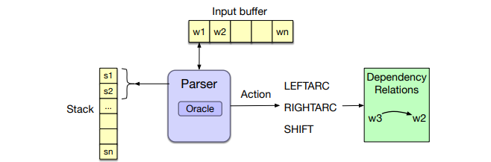
Dependency Parsing
Architecture of a dependency parser:
A dependency parser looks similar in architecture to a shift-reduce constituency parser
Primary difference is the lack of any system of rules on which reductions are performed
Set of production/reduction rules as in a constituency parser is replaced by an “oracle” that learns labeled edges from human annotated data

Slide 56
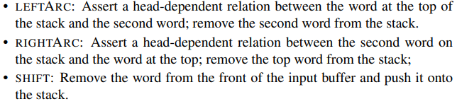
Dependency Parsing
At the beginning, stack contains a single term called [root]
On reading the sentence from left to right, one of the three operations are performed:
Shift: Shift the current word onto the stack
LeftArc: Create a relation between top two words on the stack: w₁ → w₂ and remove w₂
RightArc: Create a relation between the top two words on the stack: w₂ → w₁ and remove w₁ from the stack

Slide 57
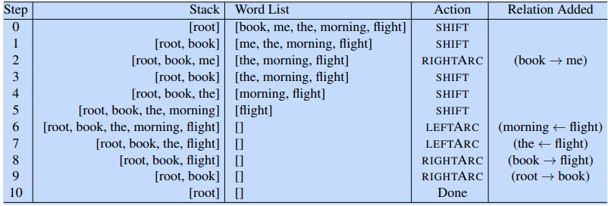
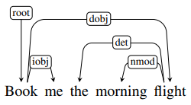
Dependency Parsing
Parsing of the sentence: Book me the morning flight

Slide 58

Dependency Parsing
Generating Oracles
The oracle predicts a transition (LeftArc, RightArc, Shift) given a specific configuration of the stack.
Treebanks do not directly contain this information for training an oracle-- since they only have entire trees for given sentences.
In order to generate training data for transitions, we simulate a sentence tree from a tree bank using a training oracle.
Given: sentence N and a dependency tree comprising of a set of vertices V, and a set of reference parse relations R_{p}
Create a training oracle with a stack S, and a set of reference relations R_{c} that is to be filled.
Let S₁ and S₂ represent the first and second elements of the stack. Read the input sentence and populate reference relations set R_{c} as follows:

Slide 59
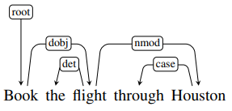
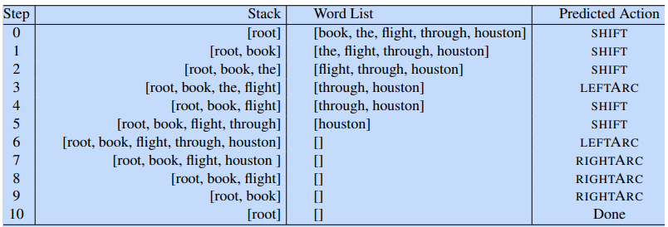
Dependency Parsing
Generating training data for the following parse:

Slide 60
Dependency Parsing
Training the oracle
Different techniques are used to train the oracle to predict a dependency relation, given a stack and input buffer configuration.
In the simplest case, the stack and input buffer are converted to their POS tag pattern to generalize on the input:
For instance, let s₁.w and s₂.w represent the top two words on the stack, and let b₁.w represent the first word on the input buffer.
Similarly, let s₁.t, s₂.t, b₁.t represent respective POS tags, and the term op represent the corresponding operation (LectArc, RightArc, Shift).
Different combinations of the above are created as training features to be used to train a multinomial classifier:
<s₁.wt = flightNNS, op = shift>
<s₁.t.s₂.t = NNSVBD, op = RightArc>

Slide 61
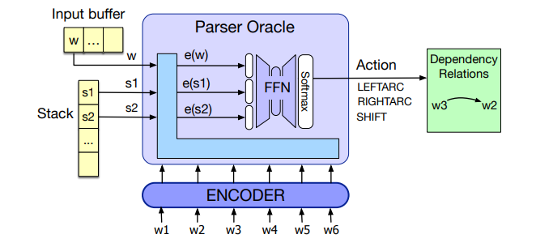
Dependency Parsing
Neural Classifier
In a neural classifier, embeddings of s₁ and s₂ along with b₁ are concatenated to form the input, with the embedding of the predicted op as the output

Slide 62
Practical Syntax Analysis

Slide 63
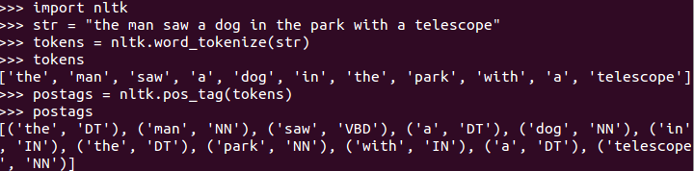
Syntax Analysis using NLTK
Tokenizing and Tagging
NLTK comes with ready made methods for tokenizing a sentence and POS tagging

Slide 64
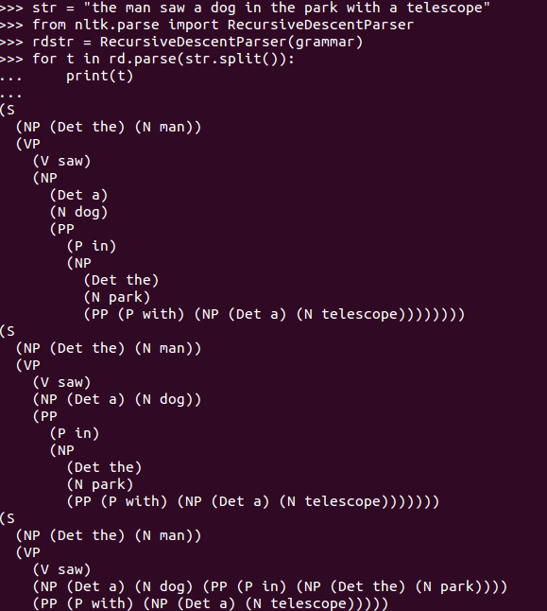
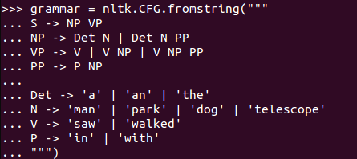
Syntax Analysis using NLTK
Specification of a CFG
Parse a sentence using Recursive Descent (top-down) parser

Slide 65
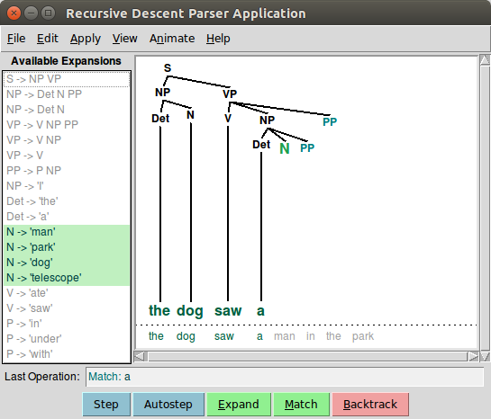
Syntax Analysis using NLTK
nltk.app.rdparser() provides a demo of a top-down Recursive Descent parser where we can trace the steps of a parse
Large grammar structures can be written as a file and loaded into nltk:
grammar = nltk.data.load('file:mygrammar.cfg')

Slide 66
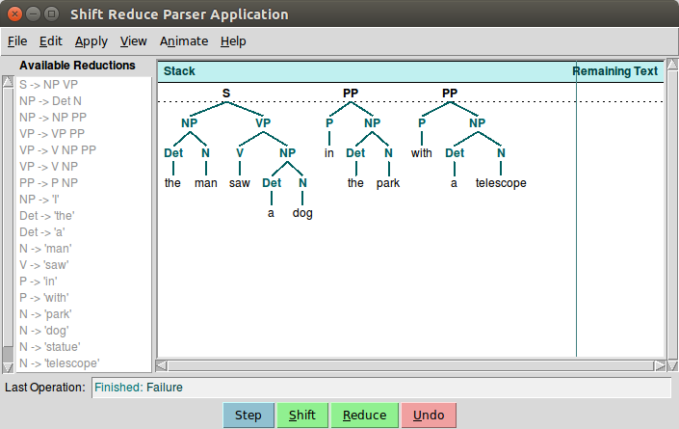
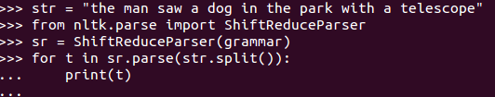
Syntax Analysis using NLTK
Parsing using Shift Reduce (bottom-up) parser:
Shift Reduce parser tries to aggregate the string to the start symbol. It outputs only one parse tree, and is not guaranteed to find a parse tree even if one exists.
nltk.app.srparser() demo shows the trace:

Slide 67
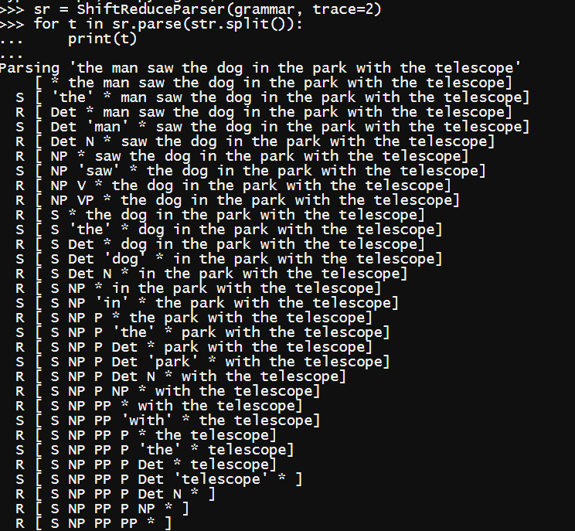
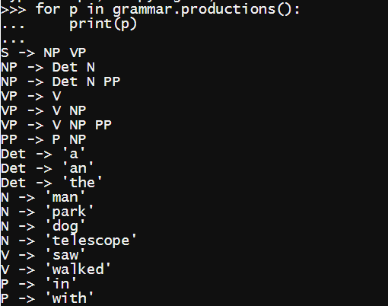
Syntax Analysis using NLTK
Use the “trace” flag while loading the grammar, to show the parsing trace.
Use the productions() method to view the grammar.

Slide 68
Stanford Parser
Constituent Parse:
(ROOT (S (NP (DT the) (NN man)) (VP (VBD saw) (NP (DT a) (NN dog)) (PP (IN in) (NP (DT the) (NN park))) (PP (IN with) (NP (DT a) (NN telescope))))))
From: http://nlp.stanford.edu:8080/parser/index.jsp
Input text:
the man saw a dog in the park with a telescope
Tagging output:
the/DT
man/NN
saw/VBD
a/DT
dog/NN
in/IN
the/DT
park/NN
with/IN
a/DT
telescope/NN
Universal dependencies:
det(man-2, the-1) nsubj(saw-3, man-2) root(ROOT-0, saw-3) det(dog-5, a-4) dobj(saw-3, dog-5) case(park-8, in-6) det(park-8, the-7) nmod(saw-3, park-8) case(telescope-11, with-9) det(telescope-11, a-10) nmod(saw-3, telescope-11)

Slide 69
References
[MS 99] Manning, Christopher D., and Hinrich Schütze. Foundations of statistical natural language processing. MIT press, 1999.
[Niv 05] Nivre, Joakim. "Dependency grammar and dependency parsing." MSI report 5133.1959 (2005): 1-32.

Slide 70
End of Mandate 3

